Slide 1
SeCURE DATA HIDING IN IMAGES USING STEGANOGRAPHY
CAPSTONE PROJECT
Presented By
Student Name :NAVYAJYOTHI SADINENI
College Name & Department : VIGNAN’S NIRULA INSTITUTE OF TECHNOLOGY AND SCIENCE FOR WOMEN & EEE

Slide 2
OUTLINE
Problem Statement
Technology used
Wow factor
End users
Result
Conclusion
Git-hub Link
Future scope

Slide 3
Problem Statement
Develop a steganography-based encryption and decryption system that securely hides secret messages within images. The system should provide a graphical user interface (GUI) for users to encode and decode messages using a password. It must ensure message integrity while allowing seamless switching between encryption and decryption modes without data loss or text modification. The solution should be user-friendly, error-free, and efficient for practical use.

Slide 4
Technology used
Programming Language: Python
GUI Framework: Tkinter
Image Processing: OpenCV (cv2)
Data Storage & Encoding: NumPy
Encryption Technique: Steganography
File Handling & OS Operations: OS Module

Slide 5
Wow factors
Secure Message Hiding – Uses steganography to conceal text within images, making it nearly undetectable.
User-Friendly GUI – Simple and intuitive interface for encryption and decryption.
Password Protection – Ensures only authorized users can decode hidden messages.
Efficient & Fast Processing – Quick encoding and decoding without significant image distortion.
Seamless Mode Switching – Allows smooth transition between encryption and decryption without data loss.
Error Handling & Validation – Prevents crashes and ensures a reliable user experience.
Versatile Image Support – Works with different image formats for flexibility.

Slide 6
End users
Individuals & Professionals for private messaging
Cybersecurity Enthusiasts learning encryption techniques
Journalists & Activists for secure communication
Government & Military personnel for sensitive data protection
Businesses & Corporations for confidential data sharing
Students & Researchers studying digital security

Slide 7
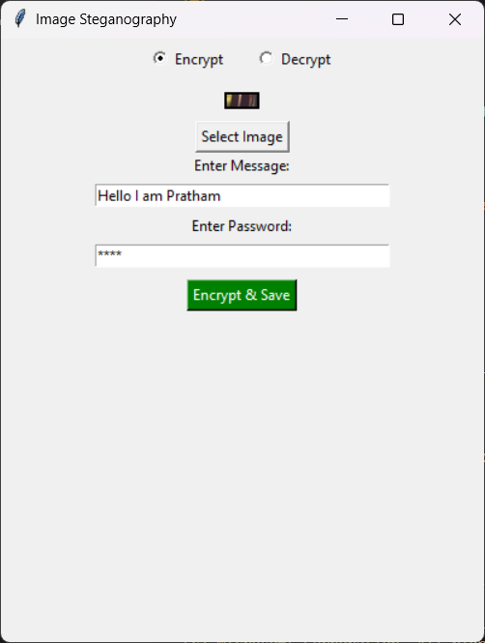
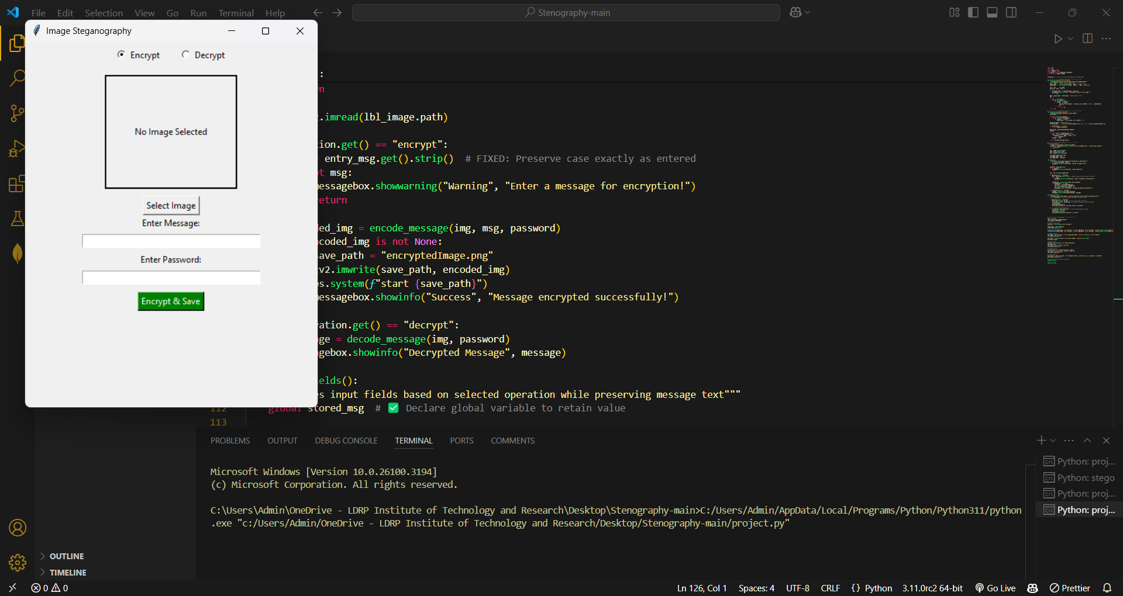
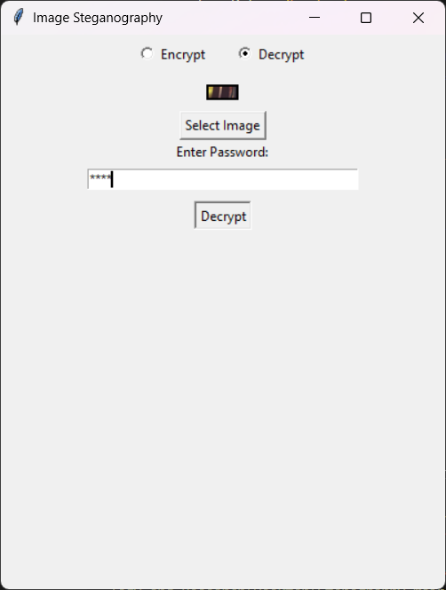
Results

Slide 8
Conclusion
This steganography-based system ensures secure and undetectable communication while maintaining ease of use.
It combines security, efficiency, and usability, making it a valuable tool for various domains.

Slide 9
GitHub Link
https://github.com/Navya-215/AICTE.git

Slide 10
Future scope(optional)
Advanced Encryption Methods – Integrate AES or RSA encryption for added security.
AI-Based Image Selection – Use AI to suggest optimal images for steganography.
Support for Video & Audio Steganography – Extend functionality beyond images.
Cloud Storage Integration – Securely store and retrieve encrypted images online.
Mobile Application Development – Create an Android/iOS app for accessibility.
Blockchain-Based Security – Ensure tamper-proof encrypted messages.

Slide 11
THANK YOU

